Slide 1
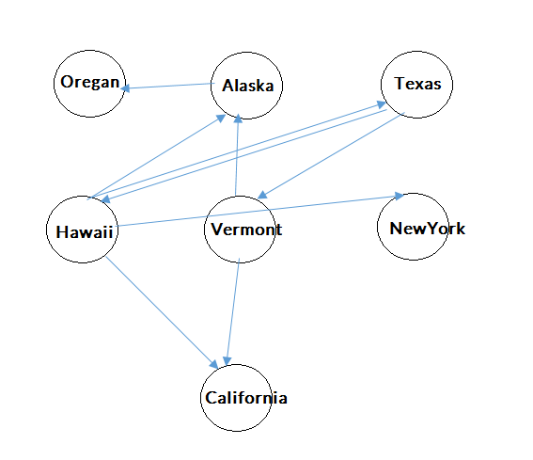
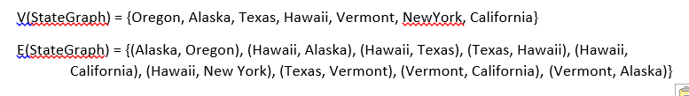
CMSC204
Kartchner
V(StateGraph) = {Oregon, Alaska, Texas, Hawaii, Vermont, NewYork, California}
E(StateGraph) = {(Alaska, Oregon), (Hawaii, Alaska), (Hawaii, Texas), (Texas, Hawaii), (Hawaii, California), (Hawaii, New York), (Texas, Vermont), (Vermont, California), (Vermont, Alaska)}
1. Draw the StateGraph
NO
YES
Texas

Slide 2
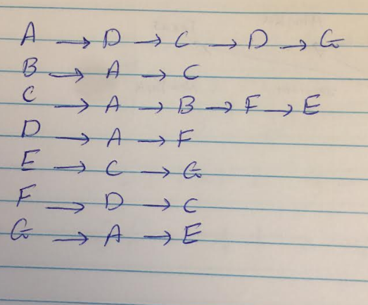
a. Show the adjacency matrix that would describe the edges in the graph. Store the vertices in alphabetical order
Alaska | 0 | 0 | 0 | 0 | 1 | 0 | 0
California | 0 | 0 | 0 | 0 | 0 | 0 | 0
Hawaii | 1 | 1 | 0 | 1 | 0 | 1 | 0
NewYork | 0 | 0 | 0 | 0 | 0 | 0 | 0
Oregan | 0 | 0 | 0 | 0 | 0 | 0 | 0
Texas | 0 | 0 | 1 | 0 | 0 | 0 | 1
Varmont | 1 | 1 | 0 | 0 | 0 | 0 | 0
States
Alaska California Hawaii NewYork Oregan Texas Varmont
3. b. Show the adjacency lists
that would describe the edges in the graph

Slide 3
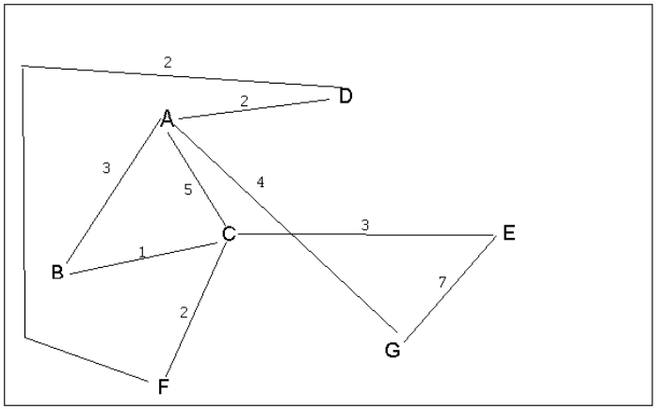
4 a. Which of the following lists the graph nodes in depth first order beginning with E?
A) E, G, F, C, D, B, A
B) G, A, E, C, B, F, D
C) E, G, A, D, F, C, B This is the correct path for DFS
D) E, C, F, B, A, D, G
4 b. Which of the following lists the graph nodes in breadth first order beginning at F?
A) F, C, D, A, B, E, G This is the correct path for BFS
B) F, D, C, A, B, C, G
C) F, C, D, B, G, A, E
D) a, b, and c are all breadth first traversals

Slide 4
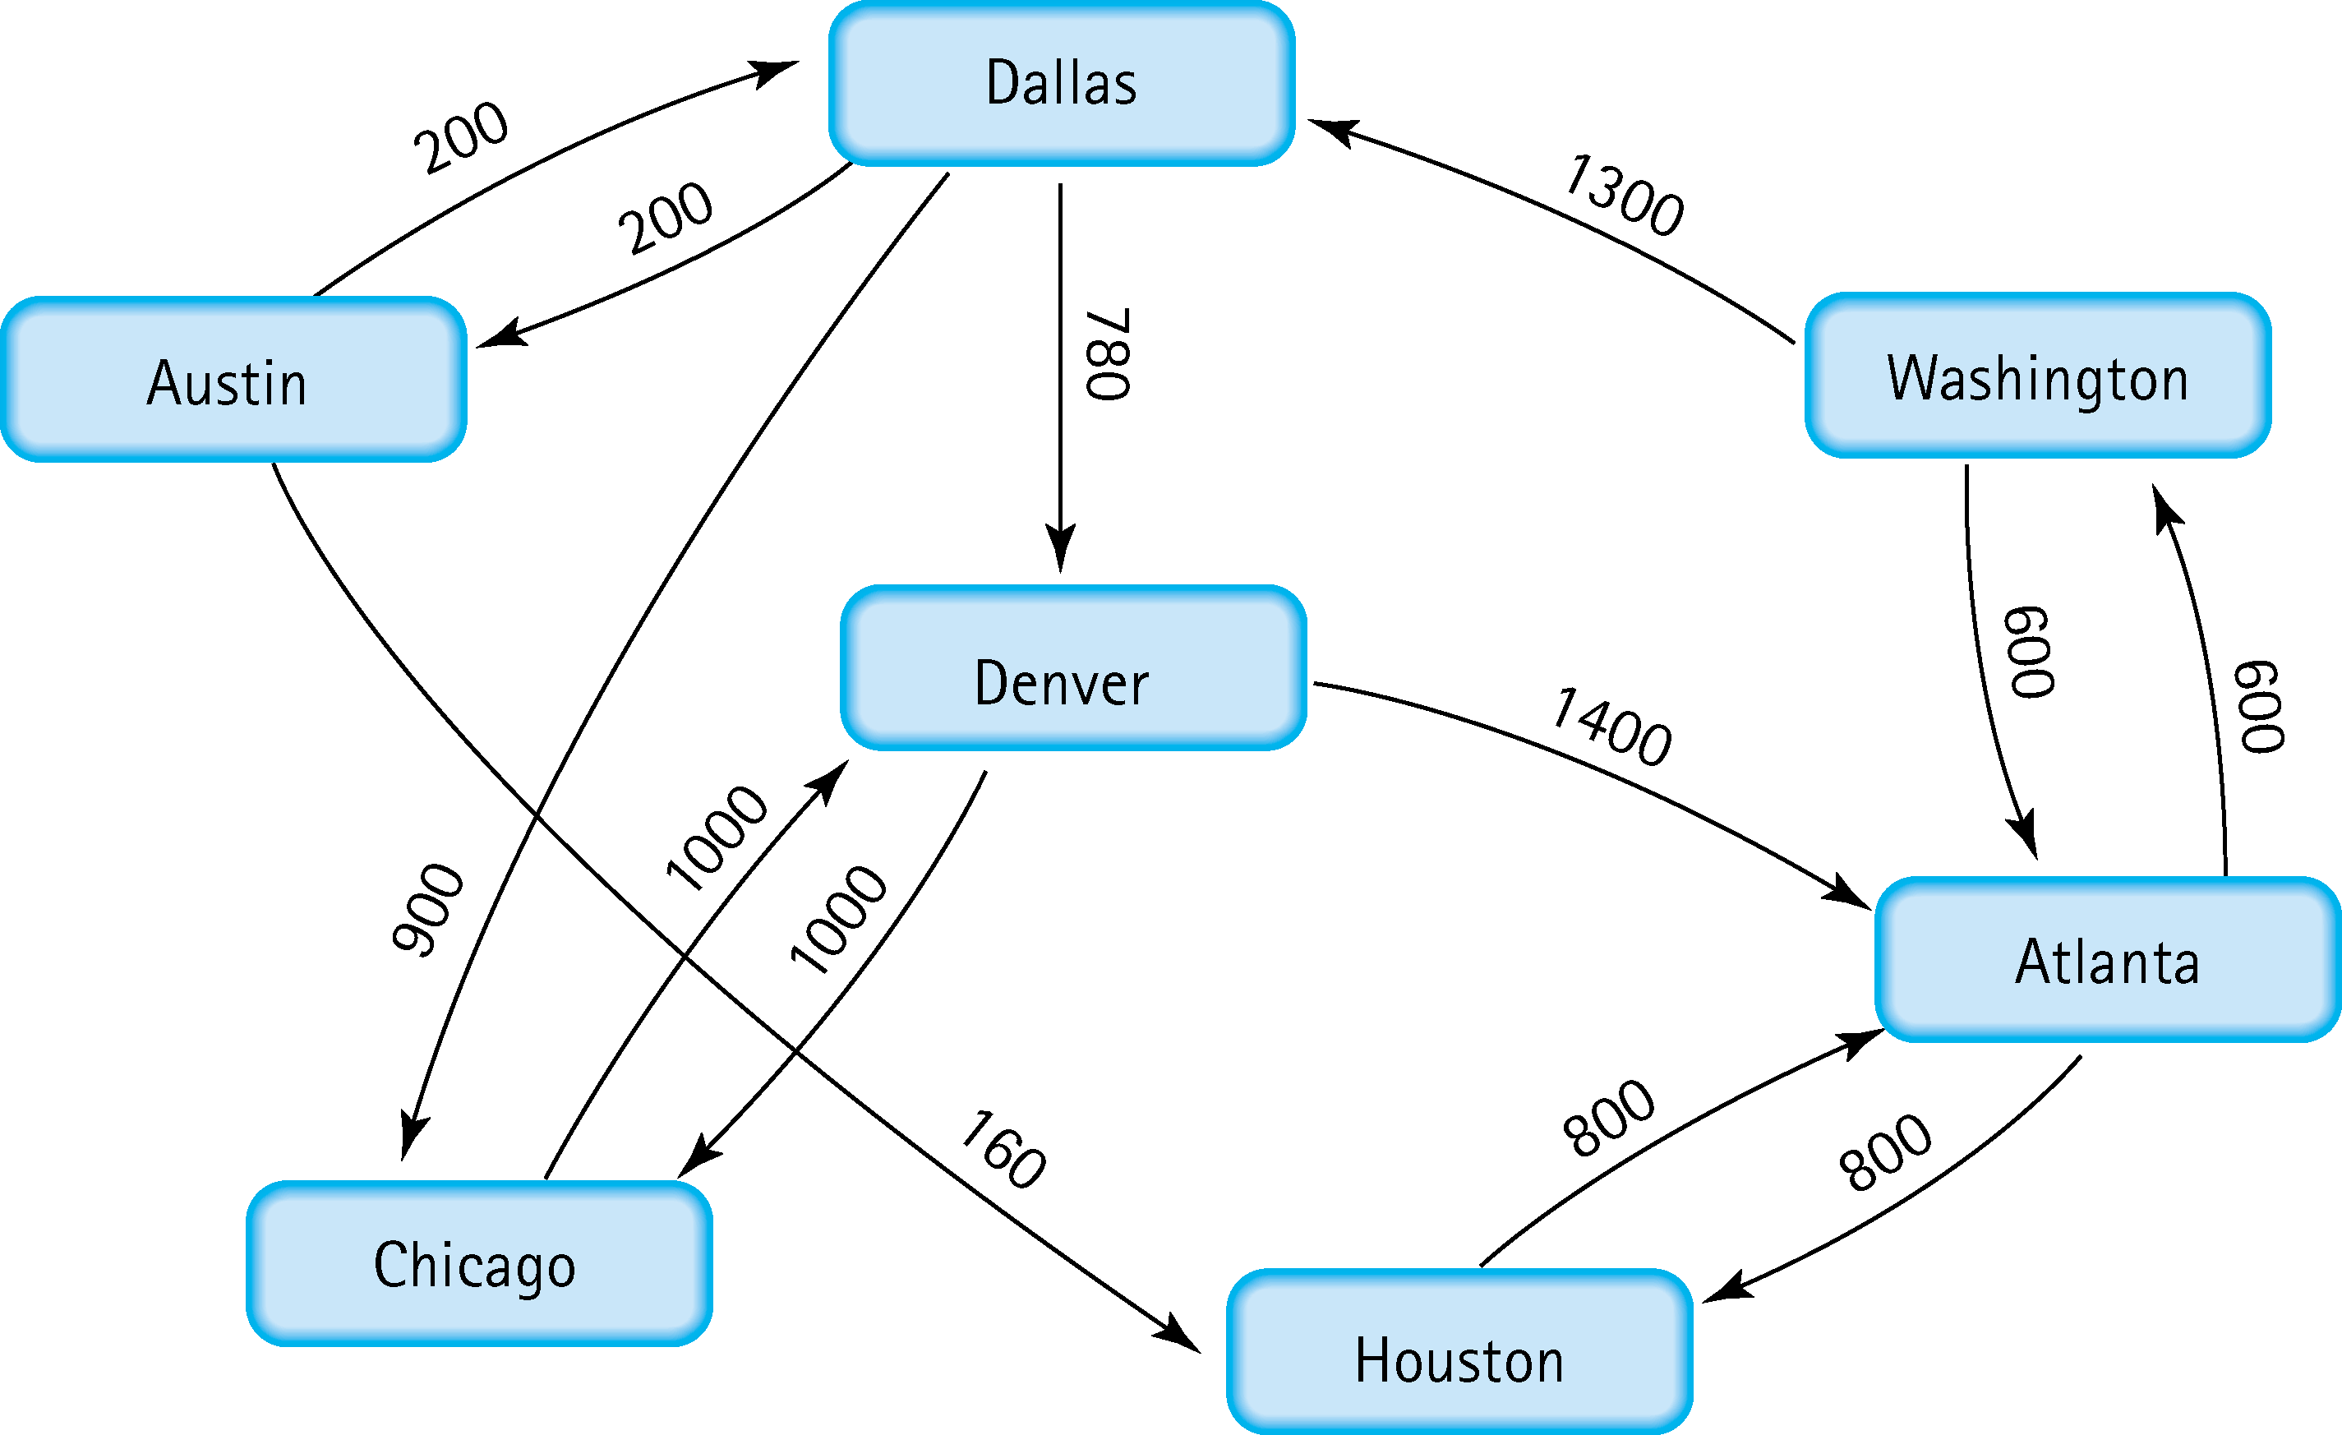
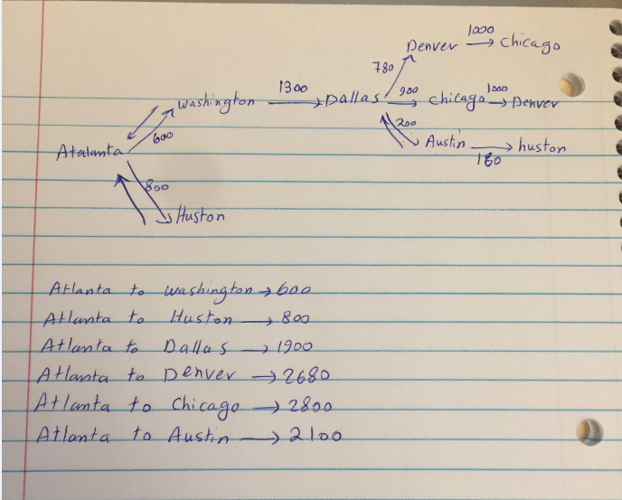
Find the shortest distance from Atlanta to every other city
ATLANTA to WASHINGTON 600
ATLANTA- to HOUSTON is 800.
ATLANTA to DALLAS 1900.
ATLANTA to DENVER 2680.
ATLANTA to CHICAGO 2800.
ATLANTA to AUSTIN 2100

Slide 5
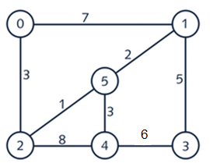
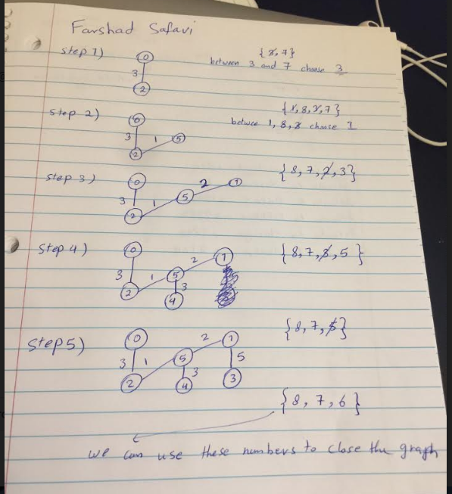
6. Find the minimal spanning tree using Prim’s algorithm. Use
0 as the source vertex . Show the steps.

Slide 6
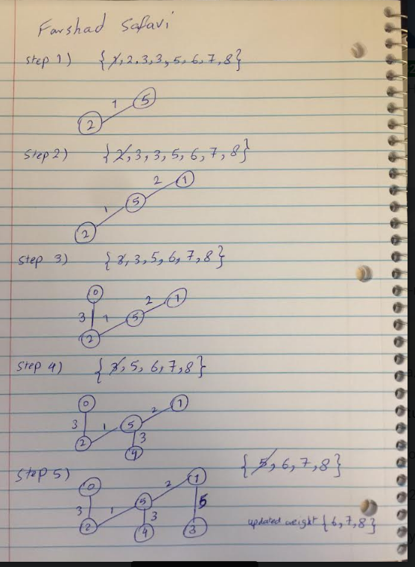
7. Find the minimal spanning tree using Kruskal’s algorithm.
Show the weights in order and the steps.

Slide 7
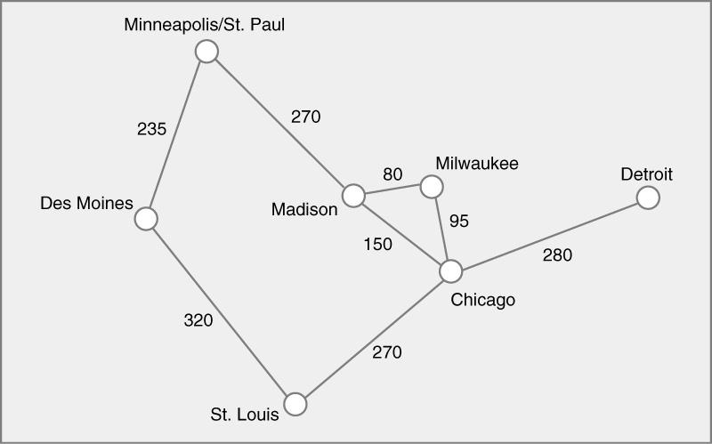
8. Find the minimal spanning tree using the algorithm you prefer. Use
Minneapolis/St. Paul as the source vertex

Slide 8
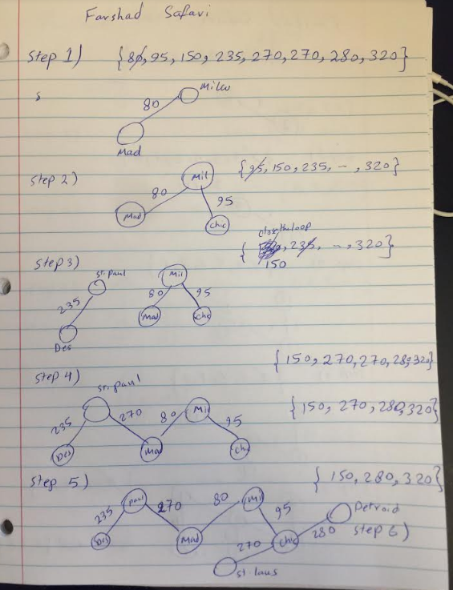

Slide 9
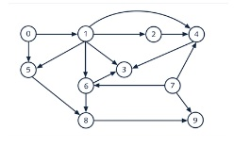

9. List the nodes of the graph in a breadth first topological ordering. Show the
steps using arrays predCount, topologicalOrder and a queue

Slide 10
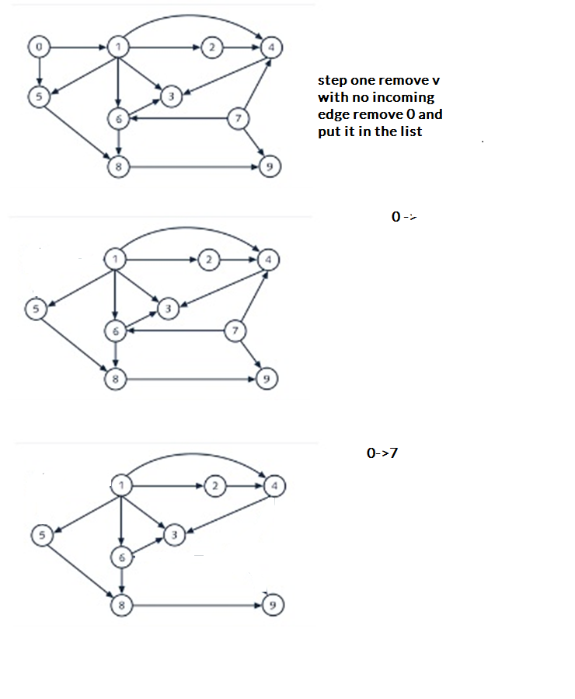

Slide 11
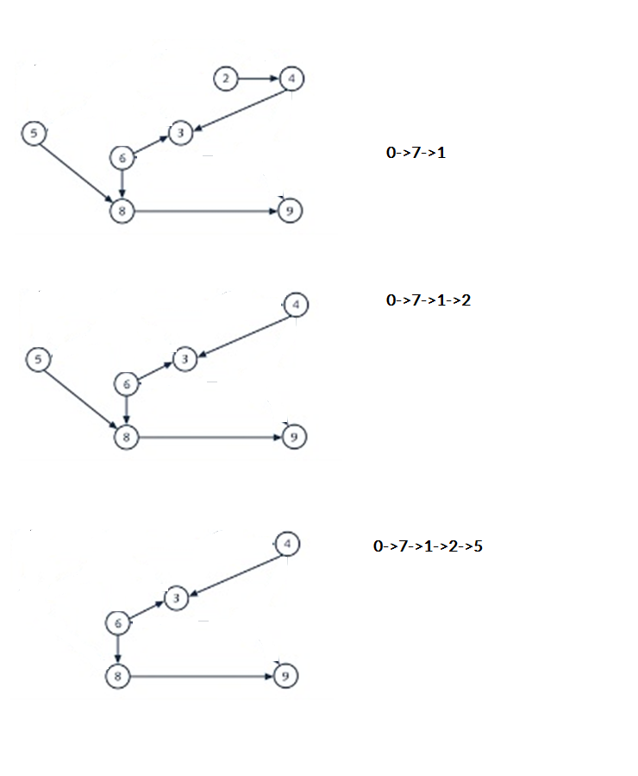
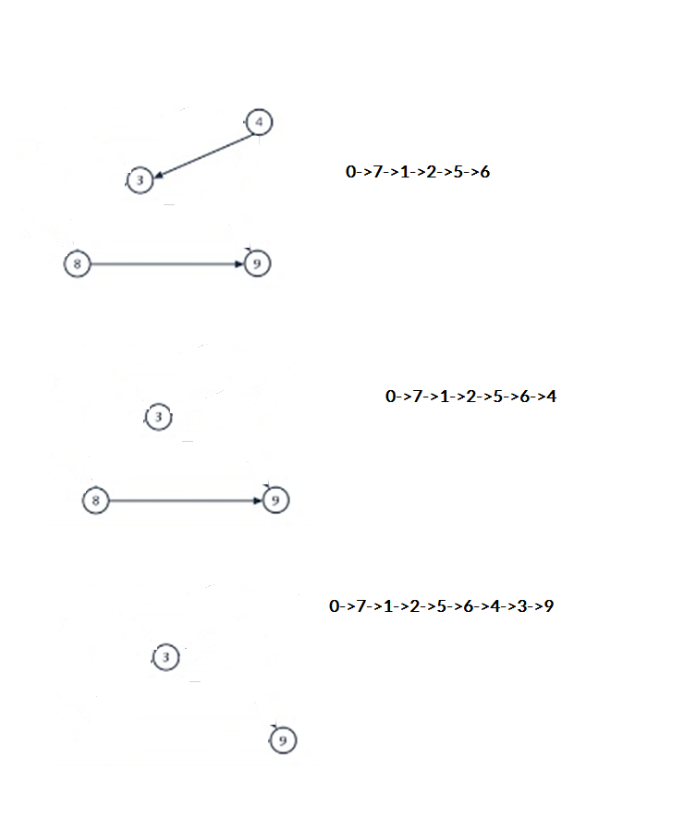


Slide 12
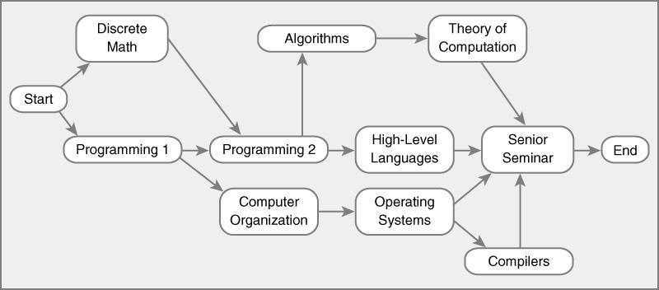
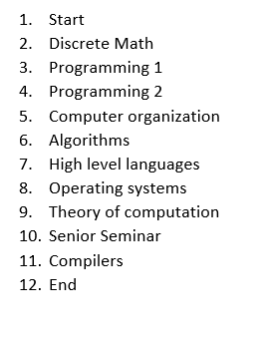
Start Discrete Math Programming 1 Programming 2 Computer organization Algorithms High level languages Operating systems Theory of computation Senior Seminar Compilers End
10. List the nodes of the graph in a breadth first topological ordering.

Slide 13
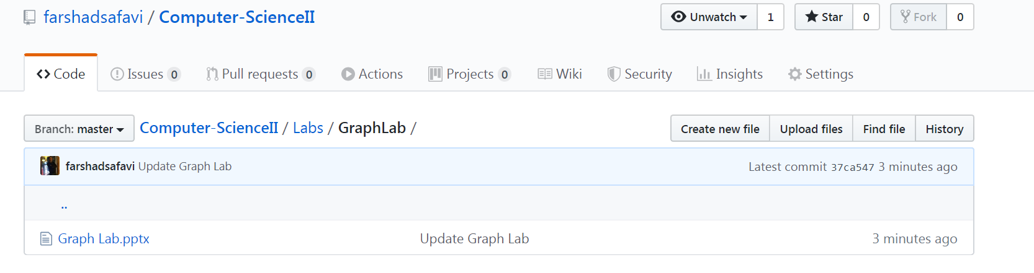
https://github.com/farshadsafavi/Computer-ScienceII/tree/master/Labs/GraphLab

